Slide 1
PERFORMANCE COMPARISON OF SNORT AND SURICATA AND IMPLEMENTATION OF MACHINE LEARNING MODEL TO SNORT SYSTEM
CS658 MALWARE ANALYSIS AND INTRUSION DETECTION FINAL PROJECT
TEAM :
TROJAN HORSES
TEAM MEMBERS :
ARCHIT GUPTA
GAJENDER SHARMA
GARGI SARKAR
KAJAL SETHI
PRANSHU SAHIJAWANI
UTKARSH SRIVASTAVA

Slide 2




AGENDA OF TODAY'S TALK
Comparison of two IDS
Identifying the better one
Implementing MLA on it
Result & Conclusion

Slide 3
INTRODUCTION
What is Intrusion ?
What is Intrusion Detection System (IDS)?
Classification of IDS:
Host-based IDS
Distributed IDS
Network-based IDS
Network based IDS:
Network traffic as the audit data source
Detect attacks from network
Importance of NIDS

Slide 4
HIGHLIGHTS
EXPERIMENT STAGE 1: Two NIDS namely Snort and Suricata were compared. Snort performed better.
01
EXPERIMENT STAGE 3 :A Snort plug-in with Decision Tree is planned to apply (task is still in processs)
03
EXPERIMENT STAGE 2: On 3 standard IDS datasets, 5 different MLA were applied. Decision Tree and SVM performed better
02

Slide 5
EXPERIMENTAL STAGE 1 : PART 1
We Observed the real time performance of Snort and Suricata by generating legitimate traffic generator OSTINATO.
Each IDS was separately installed on identical VMs with default performance parameter and rule set.
From OSTINATO, 9,00,00,000 UDP packets with rate of 50,000 packets/sec, 9,00,00,000 TCP packets with rate of 50,000 packets/sec , 9,00,00,000 ICMP packets with rate of 50,000 packets/sec were sent.
Observed CPU, memory and packet drop rate using tools namely collectl, top, dstat, snort logs, tcpdump etc.

Slide 6
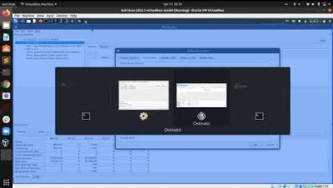
OSTINATO

Slide 7
RESULTS
The collected data from the experiment performed was recorded and observed.
Suricata's CPU utilization was higher than Snort in the whole procedure.
Suricata's average CPU utilization was 25.8359% and Snort's average CPU utilization was 3.6186%.
Suricata's memory usage is greater than that of snort i.e. snort used an average memory of 3.7489% and for Suricata it was 7.3946%.

Slide 8
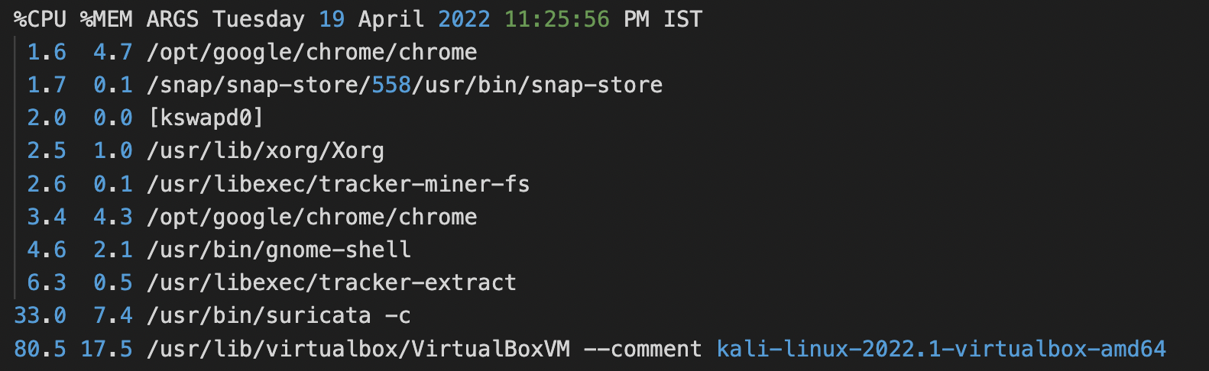
CPU-MEMORY LOGS - SURICATA

Slide 9
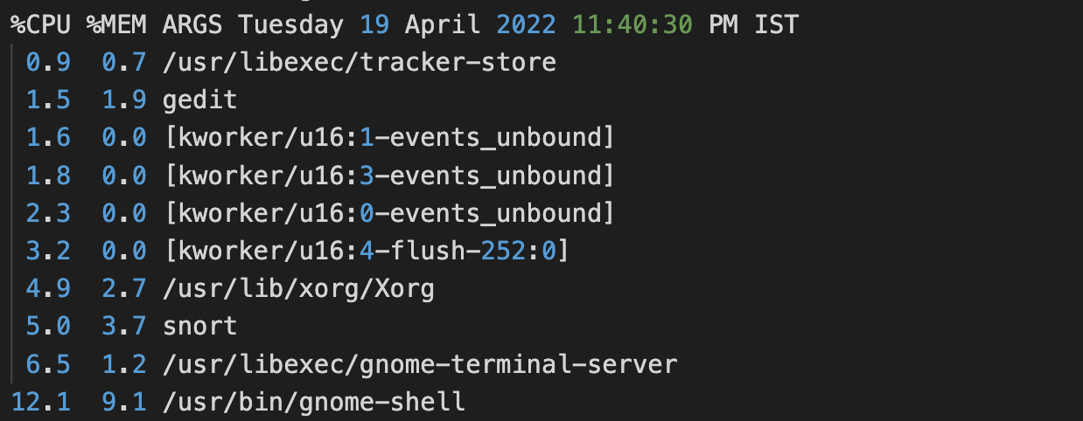
CPU-MEMORY LOGS - SNORT

Slide 10
EXPERIMENTAL STAGE 1: PART 2
GOAL:
To determine how accurately Snort and Suricata rule sets are inspecting network traffic to correctly classify the legitimate and malicious traffic.
EXPERIMENT REQUIREMENT :
Target server running HTTP, FTP, SSH services.
Sparta, Kali Linux Metasploit framework and NMAP to generate different types of malicious traffic along with legitimate traffic from OSTINATO
Default rule set and a default performance configuration of both IDS was used

Slide 11
EXPERIMENTAL STAGE: PART 2(Cont...)
EXPERIEMENT
Seven different types of malicious network traffic were injected to both IDS
As snort and Suricata are having identical rulesets, the number of alarms (false positive, false negative and true positive ) is noticed to determine which IDS is performing better.
The performance measure parameter of IDS accuracy are :
1. True Positive (TP): True is identified as true, which is correct identification
2. True Negative (TN): False is identified as false, which is correct identification
3. False Positive (FP): False is identified as true, which is wrong identification
4. False Negative (FN): True is identified as false, which is wrong identification
5. P = TP + FN (P = Total number of True instances )
6. N = FP + TN (N = Total number of False instances)
7. True Positive Rate (TPR) = TP / P = TP / (TP + FN)
8. False Positive Rate (FPR) = FP / N = FP / (FP + TN)
9. False Negative Rate (FNR) = FN / P = FN / (FN + TP)

Slide 12
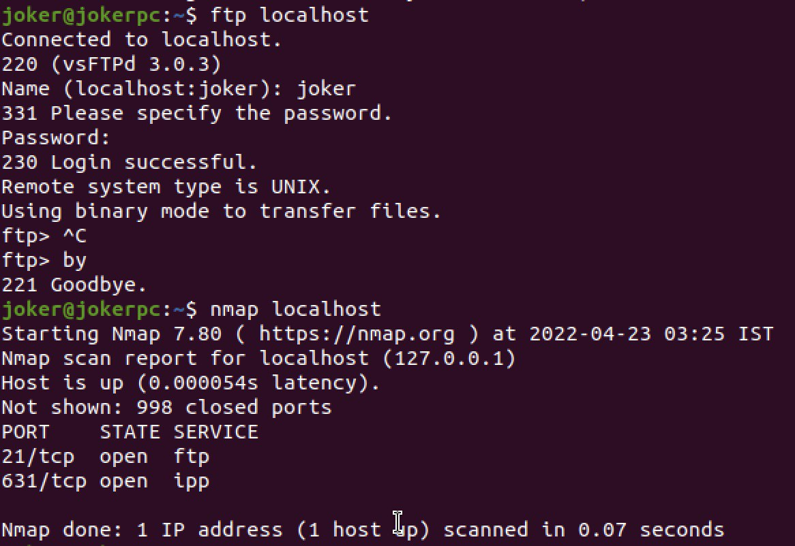
OPENING PORTS USING FTP

Slide 13
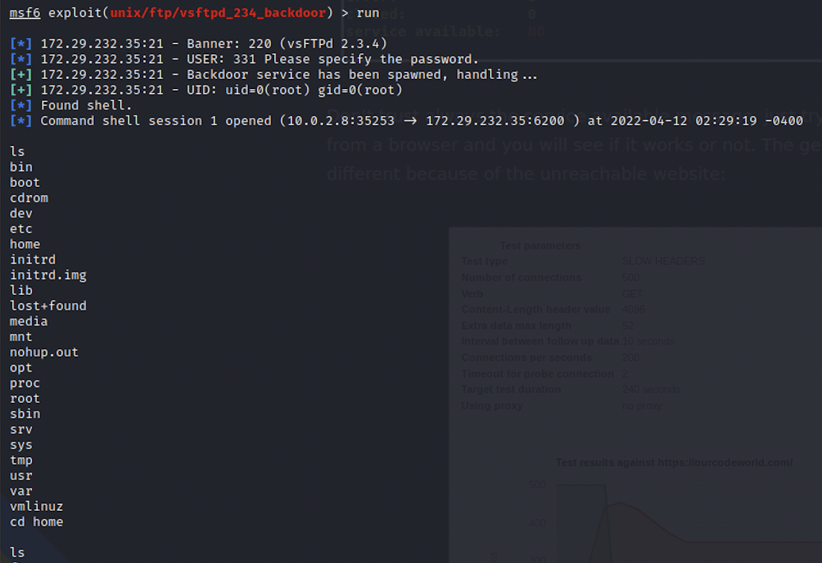
ATTACK USING METASPLOIT AND ACCESSING TARGET SYSTEM’S SHELL

Slide 14
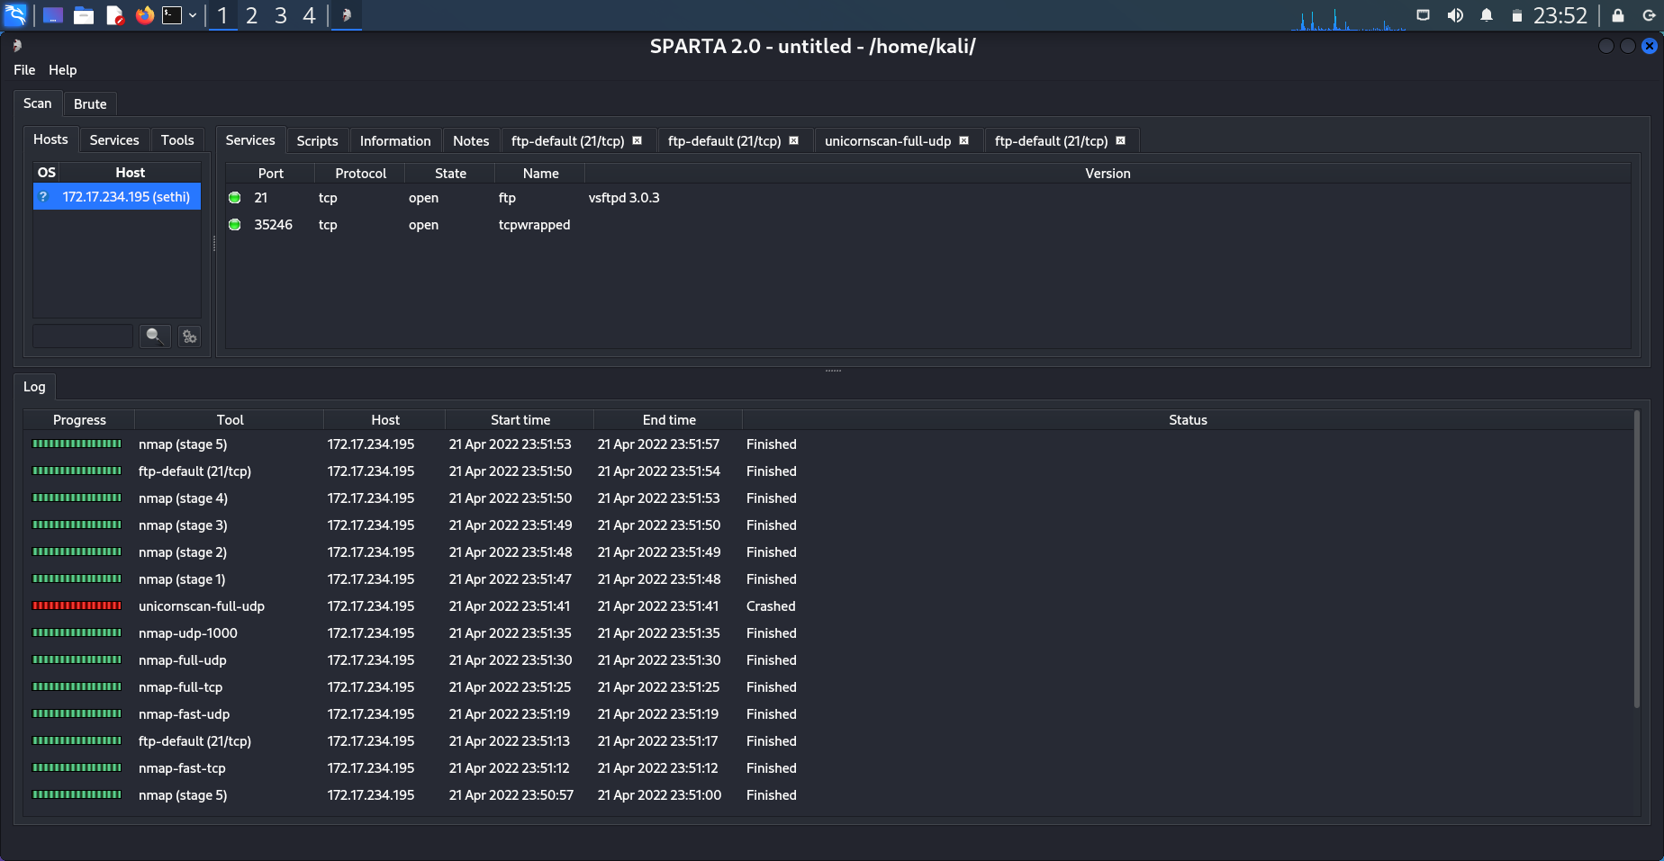
ATTACK USING SPARTA

Slide 15
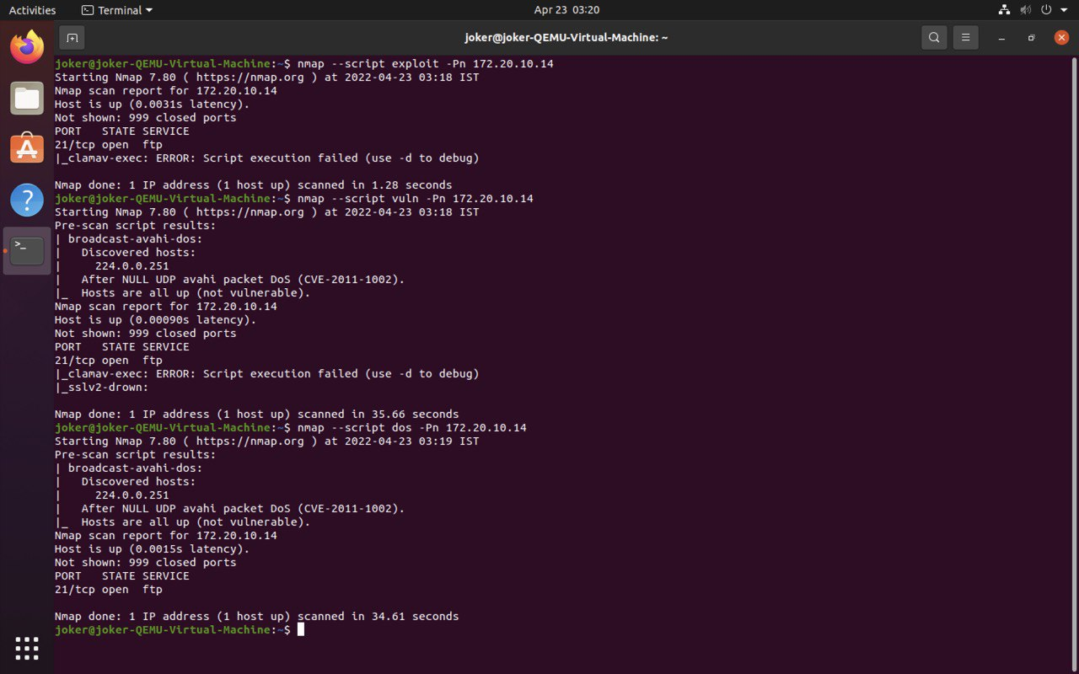
ATTACK USING NMAP

Slide 16
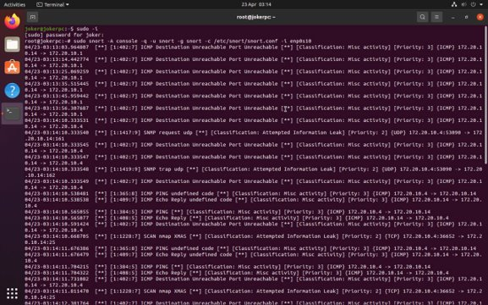
SNORT LOGS CAPTURED AFTER ATTACK

Slide 17
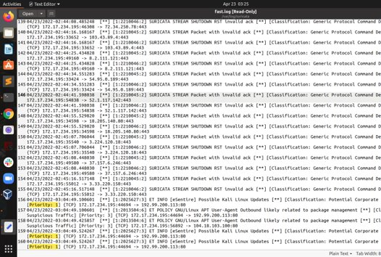
SURICATA LOGS CAPTURED AFTER ATTACK

Slide 18
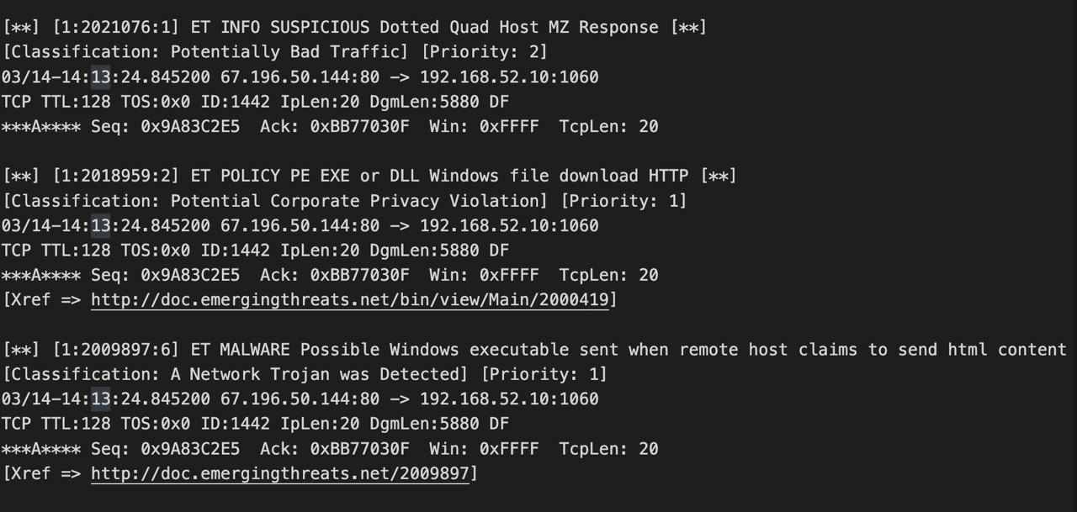
PREPOCCESING LOGS OF SNORT AND SURICATA

Slide 19
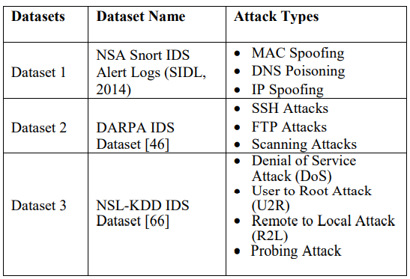
EXPERIMENTAL STAGE 2
PERFORMING WITH VARIOUS ML MODEL TO STANDARD DATASET
dd text
To Find best performing ML algorithm to apply on Snort we have used open source machine learning software WEKA
The datasets are NSA Snort IDS Alert Logs, DARPA IDS Dataset and NSL-KDD IDS Dataset
Pre-processed the data accordingly to make it run in WEKA( WEKA is a collection of machine learning algorithms for data mining tasks)
Used five algorithm( SVM, Decision tree, fuzzy logic, bayes net, naive bayes) for testing different detection accuracy on different IDS datasets
FPR, FNR, TPR were the metrics used for the comparison of detection accuracy
Based on the accuracy, the best MLA has chosen
Fig: List of standard set

Slide 20
ANALYSIS AND PERFORMANCE COMPARISON OF ML ALORITHMS
Equal number of default rule sets were used for both IDSs.
1
We did a 10th fold cross validation : 80 labelled data used for training and 20 labelled data that are used for testing
2
Recorded FPR, FNR, TPR and then calculate Detection Rate(DR) and Detection Accuracy(DA).
3
Calculated Detection Rate(DR) = TPR/(TPR+FNR)
4
Calculated Detection Accuracy(DA)= (TPR+FNR)/(TPR+FNR+FPR)
5
An algorithm is rejected if its DR is poor despite of excellent FPR or DA.
6
Among five algorithms , based on the above metrics , "J48 Decision Tree" has performed best and hence is being selected for further work
Notes:
Last box points to the work that we are going to develop plugin for that particular IDS

Slide 21
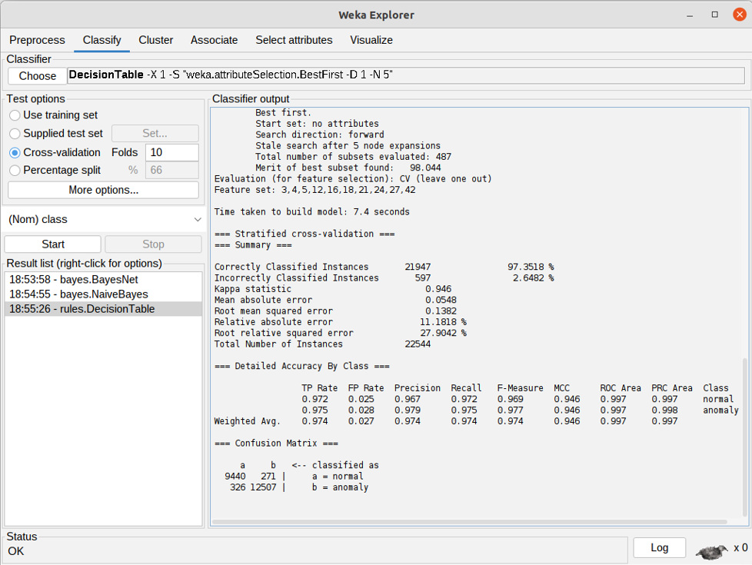
ML ON NSL-KDD IDS DATASET
DATASET 1: NSL-KDD IDS DATASET​
ML ALORITHMS​ | DR​ | FPR​ | DA​
Support Vector Machine​ | 97.74%​ | 6.71%​ | 93.71%​
Decision Trees​ | 97.21%​ | 2.54%​ | 97.52%​
Fuzzy Logic​ | 76.7%​ | 10.55%​ | 90.46%​
BayesNet​ | 95.39%​ | 5.07%​ | 95.18%​
NaiveBayes​ | 95.00%​ | 30.06%​ | 76.89%​
Fig: Classification using WEKA software

Slide 22
ML ON NSA SNORT IDS ALERT LOGS
DATASET 2: NSA-Snort IDS DATASET​
ML ALORITHMS​ | DR​(%) | FPR​(%) | DA​(%)
Support Vector Machine​ | 99% | 1% | 100%
Decision Trees​ | 99.08% | 0.9% | ​100%
Fuzzy Logic​ | ​99.97% | 0.87​% | ​99.12%
BayesNet​ | ​99.97% | 0.31​% | 99.68​%
NaiveBayes​ | ​99.97% | 0.75​% | 99.24​%

Slide 23
ML ON DARPA IDS DATASET
DATASET 3: IDS DATASET​​
ML ALORITHMS​​ | DR​​ | FPR​​ | DA​​
Support Vector Machine​​ | 96.41% | 3.7% | ​​99.69%
Decision Trees​​ | ​99.82% | ​2.04% | ​​98.00%
Fuzzy Logic​​ | ​​99.79% | 2.56%​​ | 97.50%​​
BayesNet​​ | ​99.27% | 7.59% | 92.94%
NaiveBayes​​ | ​​99.11% | ​10.23%​ | 90.72%​​

Slide 24
SNORT-SURICATA: COMPARISON USING ML METRICS
Metric | Snort | Suricata
FPR | 0.195 | 0.177
TPR | 0.869 | 0.746
Correctly Classified Instances | 86.8774% | 74.5785%
Incorrectly Classified Instances | 13.1226% | 25.4215%
As per the results, we have selected J48 Decision Tree classifier.
The evaluation summary is shown here.

Slide 25
EXPERIMENT STAGE 3 THE INTELLIGENT PUGLIN DEVELOPMENT
It is proposed to reduce the false positive alarms
It operates in parallel with the snort rule set
Snort rule set only detects the known malicious traffic, but using this plug in the unknown or variant malicious traffic can be detected which in turn will reduce false positive alarm : hence improvement of detection accuracy .
Notes:
As shown earlier, Snort triggered higher number of false positive alarms #(55.2% average)#.
The proposed Snort adaptive plug-in architecture for Snort is to reduce the false positive alarms using machine learning algorithms. The proposed Snort adaptive plug-in operates in parallel with the Snort’s rule set. The rationale for integrating the Snort adaptive plug-in parallel with the rule set is because the Snort rule set only detects the known malicious traffic. The unknown or variant malicious traffic can be detected by the plug-in which in turn can reduce the false positive alarms. This reduction in false positive alarms will obviously improve the detection accuracy.

Slide 26
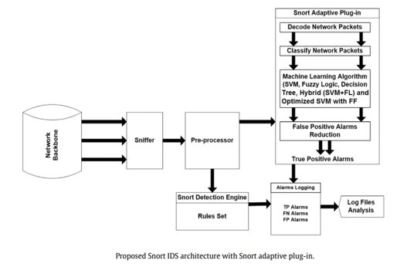
ARCHITECTURE OF THE PLUGIN
The idea is to modify the existing snort architecture and integrate the additional plug-in which results in a new architecture.
The prep-processor will input the network traffic into the plug-in and the rule set and both will operate parallel to more accurately detect the malicious traffic
The adaptive plug in is having 4 component :
Decode network packets
Classify network packets
Machine learning algorithm
False positive alarm reduction
The plug-in is a script file written in 'g' programming language
Notes:
The pre-processor will input the network traffic into the plug-in and Snort rule set and both will operate in parallel to more accurately detect the malicious traffic. The adaptive plug-in will have 4 components as follows: (1) Decode Network Packets: This component decodes the packet data to obtain detailed information: source and destination IP addresses/ports, MAC addresses, Ethernet frame and packet size.
(2) Classify Network Packets: This differentiates between legitimate and malicious traffic.
(3) Machine Learning Algorithm: Adaptive Plug-in uses SVM, Fuzzy Logic, Decision Tree, hybrid of SVM and Fuzzy Logic, and optimized SVM with firefly algorithm to process the legitimate and malicious traffic. (4) False Positive Alarm Reduction: This component further reduced the false positive alarms to send the true positive alarms to Snort log files.

Slide 27
CONCLUSION
In this project, we have compared the performance of open source IDS namely Snort and Suricata.
They both proved to be efficient and high performing IDS though having own strength and weaknesses.
Snort utilized less computational resources than Suricata whereas Suricata processed a higher number of packets per second .
Snort is having a higher detection accuracy.
Both IDS have a high rate of false positive alarms.
Suricata detected fewer type of malicious attack( research says it is because of its incapability of detecting data link layer traffic.)
J48 is the superior ML algorithm among the algorithms as it reduced the false positive rate to a greater degree.
Hence, snort adaptive plugin using J48 will reduce the FPR of snort.
Notes:
In this project, we have compared the performance of open source IDS namely Snort and Suricata where they both proved to be efficient and high performing IDS though having own strength and weaknesses. Snort utilized less computational resources than Suricata whereas Suricata processed a higher number of packets per second .Moreover, Snort is having a higher detection accuracy. Both IDS have a high rate of false positive alarms. Suricata detected fewer type of malicious attack (research says it is because of its incapability of detecting data link layer traffic.) After applying ML algorithms, we have analyzed that J48 is the superior ML algorithm among the algorithms as it reduced the false positive rate to a greater degree. Hence, snort adaptive plugin using J48 will reduce the FPR of snort. The plug-in is a script file written in ‘g’ programming language (where ‘g’ is a C programming language in Linux operating system).

Slide 28

DEMO

Slide 29
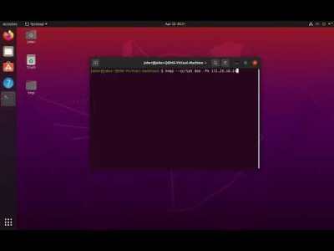
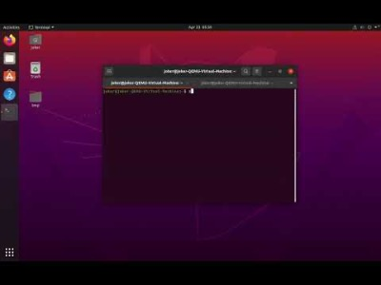
1. SNORT, NMAP, 2. SNORT, SPARTA
Note: Similar is the capturing mechanism for Suricata

Slide 30

THANK YOU!
QUESTIONS?

